Slide 1

Supply and Demand
Automatically Detecting levels of support and resistance on multiple time frames in real-time.

Slide 2
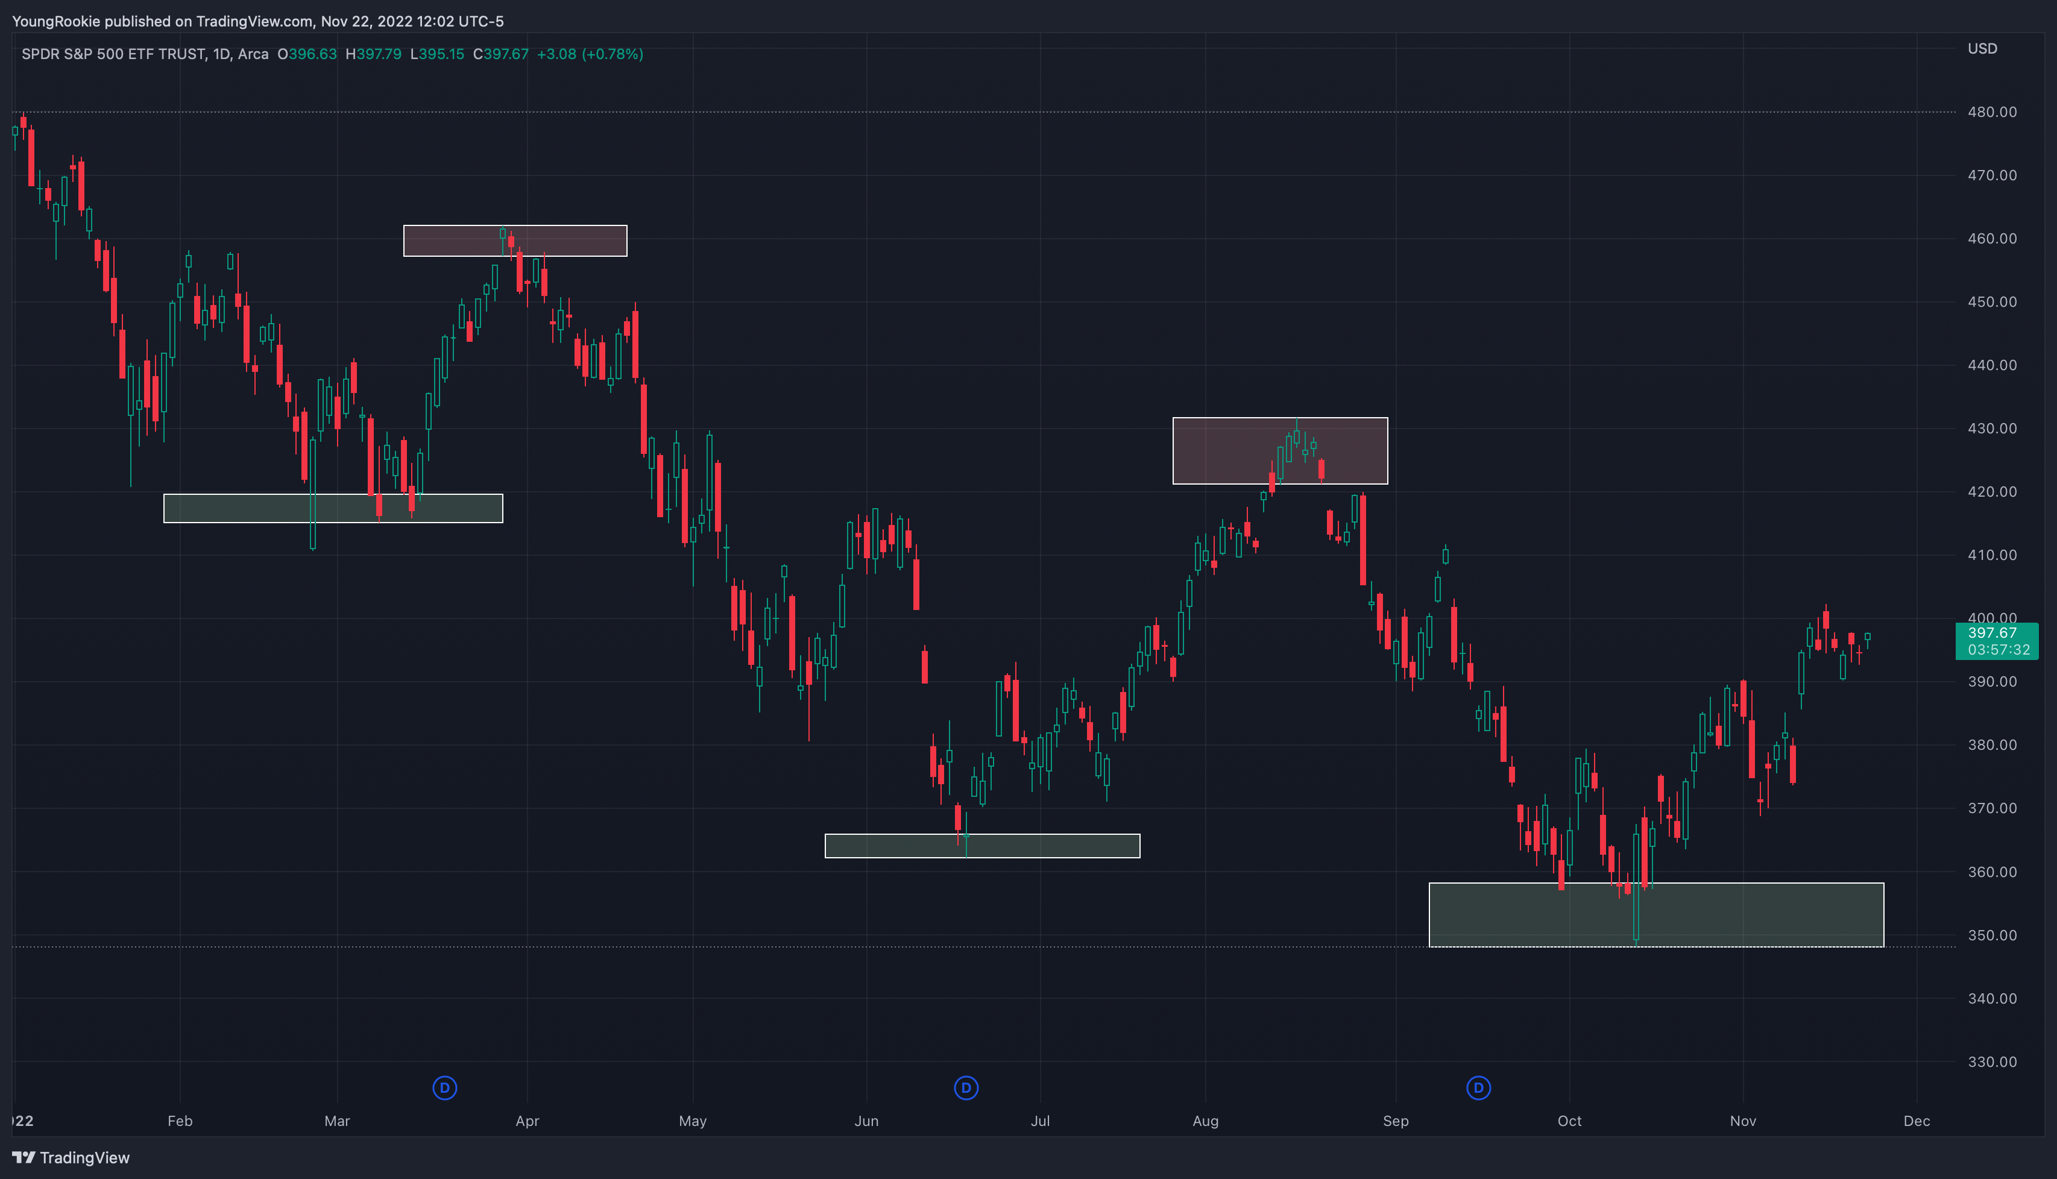
Flexibly being able to detect and predict levels of support and resistance will allow algorithms to be more successful and alleviates the need to constantly monitor volume, time and sales data.

